Slide 1
Humanistic Theories of Organizations
17/Aug/2015

Slide 2
Humanistic Theories of Organizations Human Relations Theory
The Hawthorne Studies
Theory of Organization and Concept of Authority

Slide 3
Principles of Human Relations Theory
Human relations theory is characterized by a shift in emphasis from Task to Worker
Go beyond physical contributions to include creative, cognitive, and emotional aspects of workers
Based on a more dyadic (two-way) conceptualization of communication.
Social Relationships are at the heart of organizational behaviour--effectiveness is contingent on the social well-being of workers
Workers communicate opinions, complaints, suggestions, and feelings to increase satisfaction and production

Slide 4

Origins of Human Relations Theory-HAWTHORNE EXPERIMENTS AND HUMAN RELATIONS

Slide 5


Slide 6
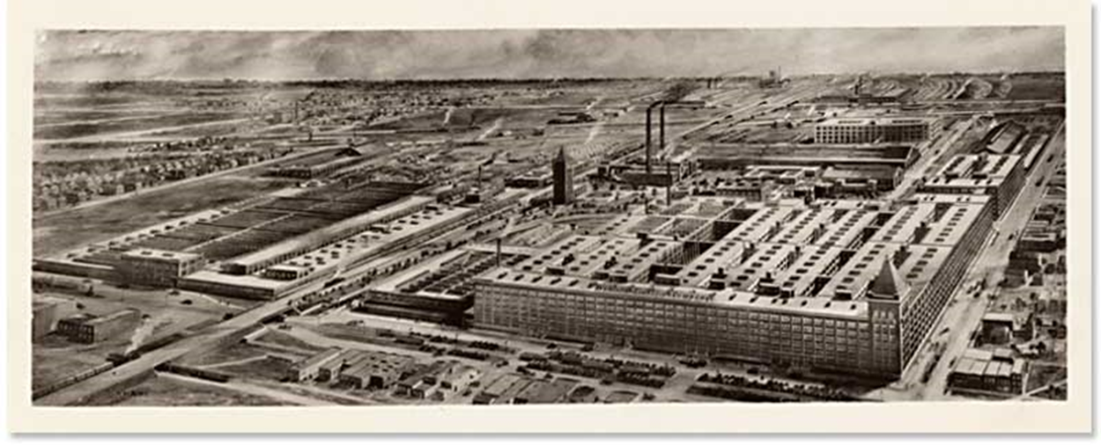
Airplane View of Hawthorne Works.

Slide 7
The Hawthorne plant of General Electric Company, Chicago, was manufacturing telephone system bell.
It employed about 30,000 employees at the time of experiments.
In respect of material benefits to workers, this was the most progressive company with pension and sickness benefits and other recreational facilities, there was great deal of dissatisfaction among the workers and productivity was not up to the mark.
After the utter failure of an investigation conducted by efficiency experts, in 1924, the company asked for the assistance form the national academy of sciences to investigate the problems of low productivity.

Slide 8
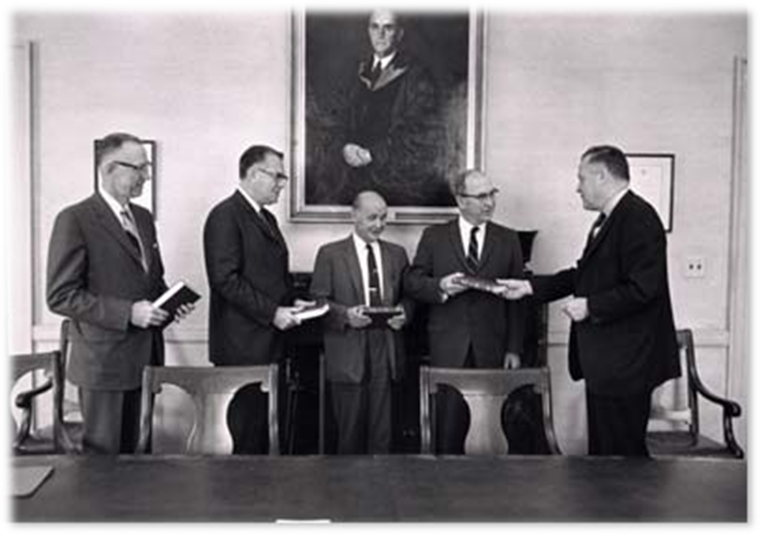
A team was constituted led by Elton Mayo (psychologist), Whitehead(Industrial Worker),Roethlisberger(Social Scientist and Management Theorist) and William Dickson. The researchers set out to study the relationship between productivity and physical working conditions.

Slide 9
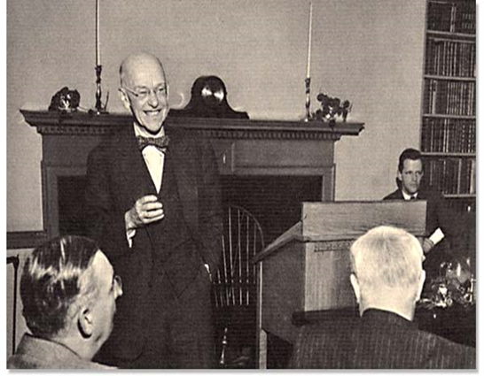
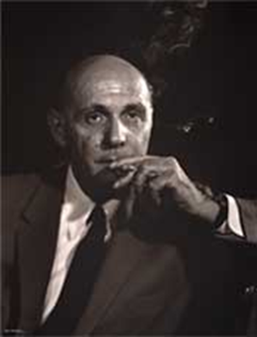
George Elton Mayo
He was an Australian Psychologist, Sociologist and Organization Theorist.
Lectured at University of Queensland before moving to the University of Pennsylvania
Spent most of his career at Harvard Business School and was the Professor of Industrial Research
Known as the founder of Human Relations Movement
Also known for his research including Hawthorne Studies
Fritz Roethlisberger
He was a Social Scientist and Management Theorist
He was also the Professor of Harvard Business School

Slide 10
The Hawthorne studies were conducted in order to find out the role of human resource in increasing the production of an organization.
The four phases:
Experiments to determine the effects of changes in illumination on productivity, illumination experiments (1924-27)
Experiments to determine the effects of changes in hours and other working conditions on productivity, relay assembly test room experiments(1927-28)
Conducting plant-wide interviews to determine worker attitudes and sentiments, mass interviewing programme(1928-30)
Determination and analysis of social organization at work, bank wiring observation room experiments(1931-32)

Slide 11
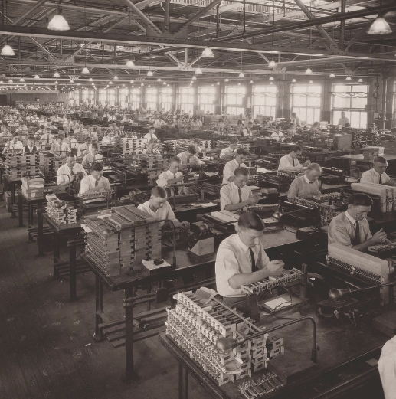
The Hawthorne experiment were first conducted in November, 1924 at western electric company’s Hawthorne plant in Chicago
ILLUMINATION EXPERIMENTS (1924-1927)
This was undertaken to find out how varying levels of illumination(amount of light at the workplace, a physical factor) affected the productivity
The hypothesis was that with higher illumination, productivity would increase
Funded by General Electric Company
Conducted by The National Research Council (NRC) of the National Academy of Sciences with engineers from MIT

Slide 12
Purpose of the study: To study the effect of various lighting conditions on the workers productivity. Divided the workers into two groups
Group -1 :- lighting condition improved and the productivity went up
Group-2 :- lighting condition remained constant and the productivity increased
Measured Light Intensity vs. Worker Output
Result :
Higher worker productivity and satisfaction at all light levels
Worker productivity was stopped with the light levels reached moonlight intensity.
Conclusions:
Light intensity has no conclusive effect on output
Productivity has a psychological component
Concept of “Hawthorne Effect” was created

Slide 13
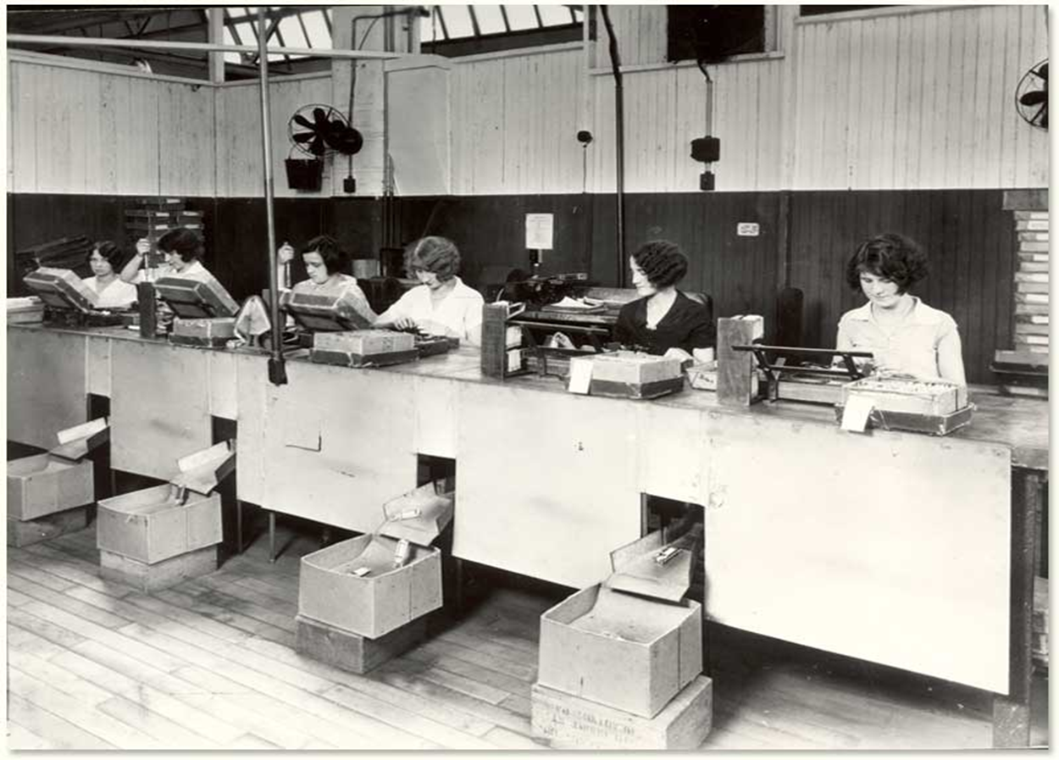
relay assembly test room experiments(1927-29)
The experiment were designed to determine the effect of changes in various job conditions on group productivity as the illumination experiment could not establish relationship between intensity of illumination and production.
For this purpose, the researchers set up a relay assembly test room.

Slide 14
Experiments were conducted by Elton Mayo
Manipulated factors of production to measure effect on output:
Pay Incentives (Each Girls pay was based on the other 5 in the group)
Length of Work Day & Work Week (5pm, 4:30 pm, 4pm, Saturday (Holiday)
Use of Rest Periods (Two 5 minutes break)
Company Sponsored Meals (Morning Coffee & soup along with sandwich)
Results:
Higher output and greater employee satisfaction, The productivity increased. Absenteeism decreased, morale increased and less supervision was required

Slide 15
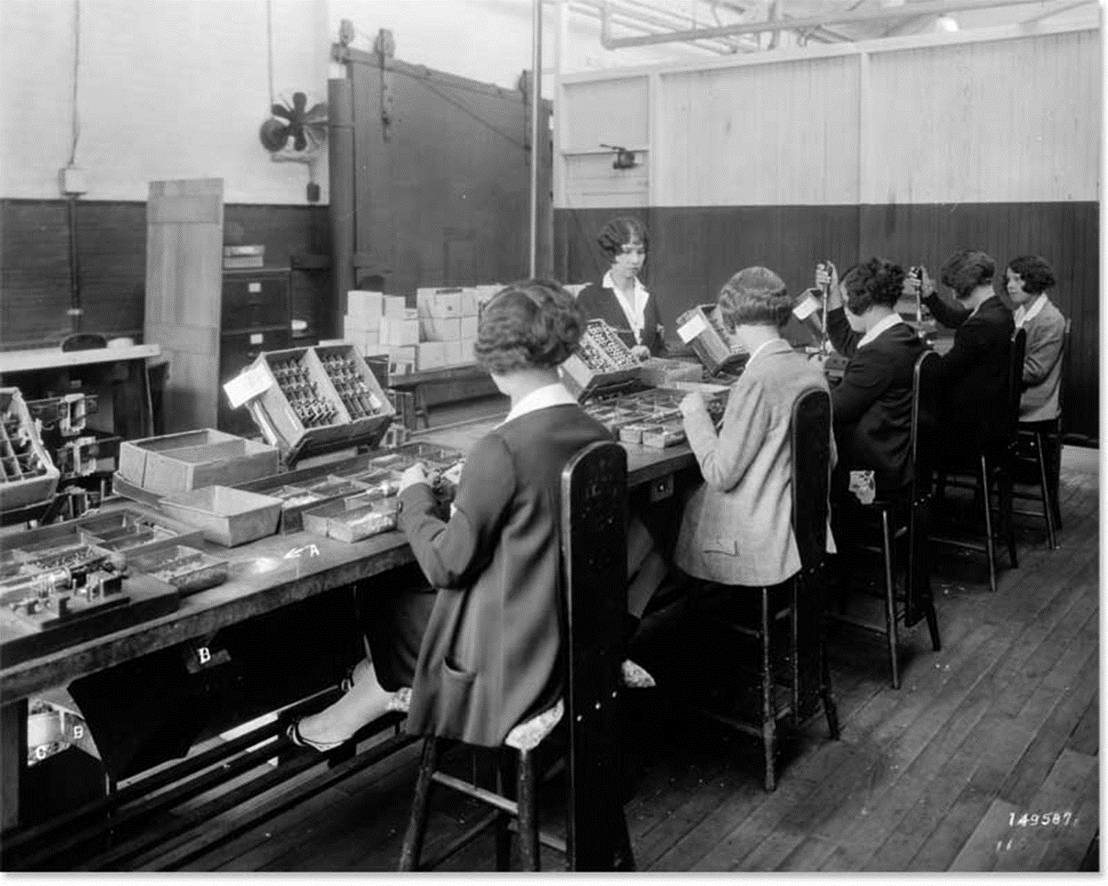
Conclusions:
Workers’ output increased as a response to attention, feeling of being important, cohesive group work, and non-directive supervision.
Strong social bonds were created within the test group. Workers are influenced by need for recognition, security and sense of belonging

Slide 16
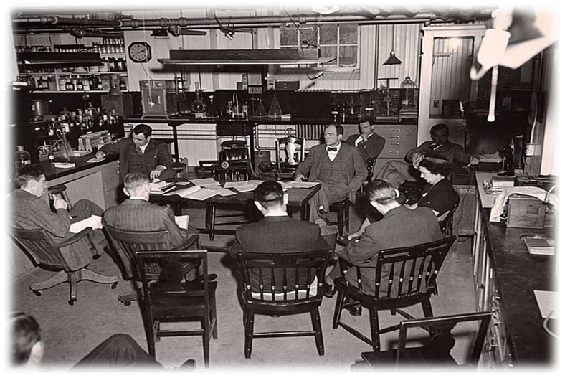
Mass Interviewing Programme (1928-30) During the course of experiments, about 20,000 interviews were conducted between 1928 and 1930 to determine employees’ attitudes towards company, supervision, insurance plans, promotions, and wages.
Objective was to explore information, which could be used to improve supervisory training.
Initially used the method of Direct Questioning and changed to Non Directive.

Slide 17
Results
- Merely giving an opportunity to talk and express grievances would increase the morale.
- Complaints were symptoms of deep-rooted disturbances.
-Workers are governed by social experience in groups obtained from both inside and outside the company.
- The social organization of the company represents a system of values from which the worker derives satisfaction or dissatisfaction.
The worker was satisfied/dissatisfied depending upon how he regarded his social status in the company.
Social groups created big impact on work.

Slide 18
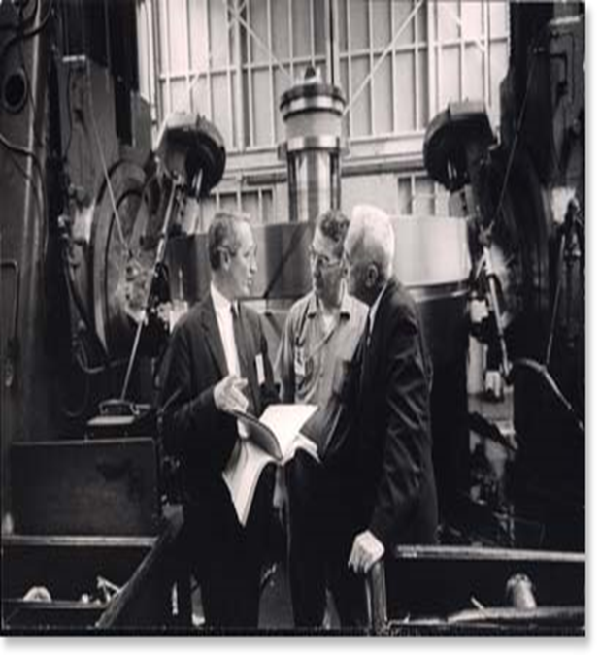
Bank Wiring Observation Room Experiments (1931-32) There experiments were carried on between November 1931 and may 1932 with a view to analyse the functioning of small group and its impact on individual behaviour.
Few Special Conditions
Segregated work area
No Management Visits
Supervision would remain the same
Observer would record data only – no interaction with workers
New incentive pay rate was established for the small group
Any increases in output would be included in departmental pay incentives
Result
output was lower than what company had determined.

Slide 19
The reasons for this output
Fear of unemployment: the basic reasoning of workers was that if there would be more production per head, some of the workers would be put out of employment .
Fear of raising the standards: most workers were convinced that once they had reached the standard rate of production, management would raise the standard of production reasoning that it must be easy to attain.
Protection of slower workers: The workers were friendly on the job as well as off the job. They appreciated the fact that they had family responsibility that required them to remain in the job. Since slower workers were likely to be retrenched, the faster workers protected them by not overproducing.
Satisfaction on the part of management: According to workers, management seemed to accept the lower production rate as no one was being fired or even reprimanded for restricted output.
The study suggested that informal relationships are an important factor in determining the human behaviour. During the course of experiments, workers were counselled for good human relations in the company's plant. The counselling was in regard to supervision , employee relations, personal adjustments and management of employee relations.

Slide 20
Conclusions:
Well established performance norms existed in the group
Informal Social Organization dictated little deviation from established production standards
Informal Social Organizations protect workers from managers who
Raise production standards
Cut pay rates
Challenge workplace norms

Slide 21
HIGHLIGHTS OF HAWTHORNE STUDIES
There is no direct relationship between worker productivity and physical factors.
The employee can be motivated by psychological and social wants because his behaviour is also influenced by feelings, emotions and attitudes. Thus economic incentives are not the only method to motivate people.
Work is considered as a group activity and not as an operation performed by an individual worker.
The human social and social factors result in the overall growth and development of the human resource.

Slide 22
Group Influence: Workers being social beings, they create groups which may be different from their official group. In fact, groups are formed to overcome the shortcomings of formal relationships. The group determines the norm of behaviour of members.
Conflicts: The informal relations of workers create groups and there may be conflict between organization and groups so created. The conflict may be because of the incompatible objectives between the two.
Leadership: Leadership cannot come only from formally-appointed superior as held by earlier thinkers. There may be informal leaders as shown by the bank writing experiments.
Supervision: Friendly to the workers, attentive, genuinely concerned supervision affects the productivity favourably.
Communication: Through communication, workers can be explained the rationality of a particular action, participation of workers can be sought in decision-making concerning the matter of their importance, problems faced by them can be identified and attempts can be made to remove these.

Slide 23
CRITICISMS OF HAWTHORNE EXPERIMENTS
It lacks validity.
More importance to human aspects
More emphasis on group decision-making
Mayo overstressed experimentation and drew conclusions from the strength of observations about a small sample of size.
The experiment lacked scientific basis.
The Hawthorne plant was not a typical plant because it was a thoroughly unpleasant place to work. Therefore, the results could not be valid for others.

Slide 24
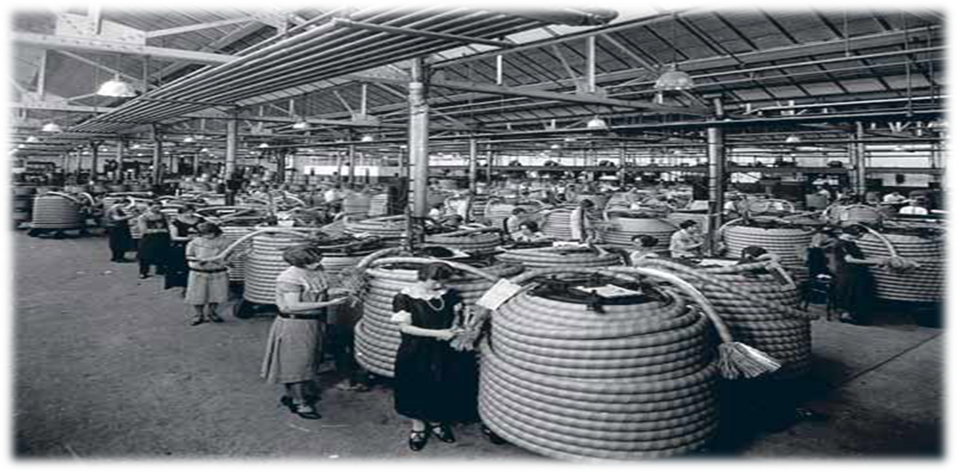
CONCLUSION
The Hawthorne studies have had a remarkable impact on management in organizations and how workers react to various situations.
Stimulated interest on human behaviour in organizations.
A lot of literature came out analysing the human behaviour in organizations.
In spite of the short comings of Hawthorne experiments, initiated a new approach to management (Human Relations Approach).

Slide 25
Theory of Organization and Concept of Authority

Slide 26
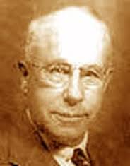
Chester I. Barnard
American business executive and public administrator
Known for The Functions of the Executive (1938)
Barnard drew attention away from formal organizational structures toward communication, cooperation, and the informal organization. His work was integrated by other theorists in the human relations movement.
(November 7, 1886 – June 7, 1961)

Slide 27

He has developed 2 concepts in Management Theory
1. Strategic Planning
The formulation of major plan or strategies to pursuit of major objectives.
3 top functions:-
i. establish and maintain an effective communication system.
ii. hire the experienced and suitable personnel.
iii. motivate those personnel.

Slide 28

2. Acceptance Theory of Authority
Managers have more authority than employees. It suggested that authority flows downward but depends on acceptance by the subordinate.
It depends on 4 conditions:-
i. employees can and do understand the communication.
ii. employees must be able to follow any instruction given by a Manager.
iii. employees must think that the directive is in keeping with organizational objectives.
iv. employees must think that the directive is not contrary to their personal goals.

Slide 29

Organization defined.
“a system of consciously coordinated activities of two or more persons.” He also said, “that an organization is held together by common purposes and goals that its members share.”
3 essential elements in an organization :-
1. Communication.
2. Persons willing to contribute action.
3. A common purpose (function).

Slide 30
An organization comes into being when:
There are persons able to communicate with each other.
There are persons willing to contribute action.
There are persons willing to accomplish a common purpose.

Slide 31
The Executive Functions:
Values of leaders.
Purpose defined by leaders.
Cooperation requires communication.
The executive must maintain organization.
To Provide the System of Communication.
Promote the Securing of Essential Efforts.
Formulate and Design the Purpose.

Slide 32
The Nature of Executive Responsibility should include the following..
Imply a Complex Morality.
Require a High Capacity of Responsibility.
Understand Conditions.
Generate Technical Ability with Moral Factors.
The Ability to Create Morals for Others.

Slide 33
Conclusions from Barnard’s Work
Physical & Biological Factors are Basic in Cooperation
All Complex Organizations Grow from Unit Organizations
Society’s Major Structure is Complex Formal Organizations
The Strategic Factor in Cooperation is Leadership

Slide 34


